Slide 1

CSCE 4603 - Computer vision
TEKNO21 - Brain Stroke Classification
TEAM MEMBERS
Mohamed Azouz
Mahmoud Refaie
Youssef Serry

Slide 2
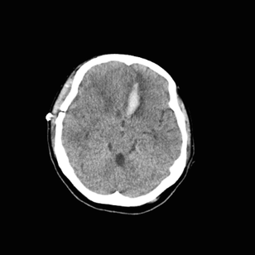
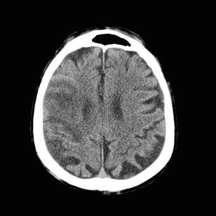
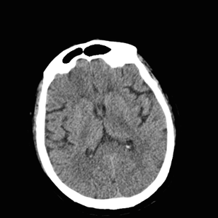
CSCE 4603 - Computer vision
Problem
Bleeding
  Hemorrhagic stroke, ischemic stroke, and normal scans may have subtle visual differences.
  This project develops a CNN-based classification system that automatically categorizes CT images into bleeding, ischemia, or normal classes.
ISCHEMIA
NORMAL

Slide 3
CSCE 4603 - Computer vision
Approach
1
2
3
Preprocess images to ideal state for CNNs.
Select suitable CNN models for the classification.
Train and compare the models.
The Goal
Develop a reliable CNN system that correctly classifies brain scans between the 3 classes.
4

Slide 4
CSCE 4603 - Computer vision
Preprocessing
Goals:
  Reduce unnecessary black background
  Resize images to ideal CNN size (224x224)

Slide 5

CSCE 4603 - Computer vision
Goals:
  Reduce unnecessary black background
  Resize images to ideal CNN size (224x224)
Preprocessing
ORIGINAL IMAGE

Slide 6

CSCE 4603 - Computer vision
Goals:
  Reduce unnecessary black background
  Resize images to ideal CNN size (224x224)
Preprocessing
Create a binary mask to identify the head region
ORIGINAL IMAGE
  THRESHOLDING

Slide 7

CSCE 4603 - Computer vision
Goals:
  Reduce unnecessary black background
  Resize images to ideal CNN size (224x224)
Preprocessing
Create a binary mask to identify the head region
ORIGINAL IMAGE
  THRESHOLDING
  CLOSING

Slide 8

CSCE 4603 - Computer vision
Goals:
  Reduce unnecessary black background
  Resize images to ideal CNN size (224x224)
Preprocessing
Create a binary mask to identify the head region
ORIGINAL IMAGE
  THRESHOLDING
  CLOSING
  OPENING

Slide 9
CSCE 4603 - Computer vision
Goals:
  Reduce unnecessary black background
  Resize images to ideal CNN size (224x224)
Preprocessing
Identify Head Region
ORIGINAL IMAGE
LARGEST CONNECTED REGION
BINARY MASK

Slide 10
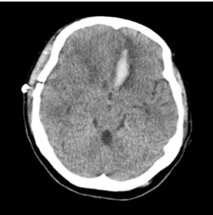
CSCE 4603 - Computer vision
Goals:
  Reduce unnecessary black background
  Resize images to ideal CNN size (224x224)
Preprocessing
Crop + pad to square
ORIGINAL IMAGE
LARGEST CONNECTED REGION
CROP + PAD TO SQUARE
BINARY MASK

Slide 11
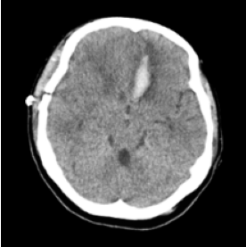
CSCE 4603 - Computer vision
Goals:
  Reduce unnecessary black background
  Resize images to ideal CNN size (224x224)
Preprocessing
Resize
ORIGINAL IMAGE
LARGEST CONNECTED REGION
RESIZE (224X224)
BINARY MASK
CROP + PAD TO SQUARE

Slide 12
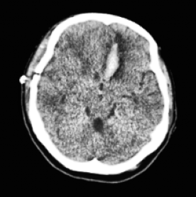
CSCE 4603 - Computer vision
Goals:
  Reduce unnecessary black background
  Resize images to ideal CNN size (224x224)
Preprocessing
Enhance Contrast
ORIGINAL IMAGE
LARGEST CONNECTED REGION
RESIZE (224X224)
APPLY CLAHE
BINARY MASK
CROP + PAD TO SQUARE

Slide 13
CSCE 4603 - Computer vision
Goals:
  Reduce unnecessary black background
  Resize images to ideal CNN size (224x224)
Preprocessing
Final Datasets
ORIGINAL
DATASET 1 (NO CLAHE)
DATASET 2 (CLAHE)

Slide 14
CSCE 4603 - Computer vision
CNN Models
Model 1
Model 2
VGG16
Resnet50
  ImageNet-pretrained convolutional network
  Feature extractor frozen during Stage 1 (20 Epochs)
  Final convolutional block fine-tuned during Stage 2 (10 Epochs)
  Global Average Pooling
  Dense layer: 256 units + ReLU
  Tested with CLAHE and without CLAHE
Test Accuracy: 87.98%
  ImageNet-pretrained residual network
  Feature extractor frozen during Stage 1
  Final residual stage fine-tuned during Stage 2
  Same classification head as VGG16
  Tested with CLAHE and without CLAHE
Best Test Accuracy: 90.78%
Common setup: 224×224 input | Batch size 16 | Adam optimizer |
Class weighting | Early stopping

Slide 15
CSCE 4603 - Computer vision
Results Comparison
Model | Dataset | Accuracy | Macro F1
VGG16 | CLAHE | 87.98% | 82.16%
VGG16 | No CLAHE | 87.98% | 82.16%
Resnet50 | CLAHE | 88.88% | 84.11%
Resnet50 | No CLAHE | 90.78% | 87.06%

Slide 16
CSCE 4603 - ComputER VISION
Thank You
TEAM MEMBERS
Mohamed Azouz
Mahmoud Refaie
Youssef Serry

